Slide 1
Learning Objective
I will be able to use discrete random variables.
Success Criteria
At the end of the lesson sequence, I will be able to:
3.3.1 develop the concepts of a discrete random variable and its associated probability function, and their use in modelling data
3.3.2 use relative frequencies obtained from data to obtain point estimates of probabilities associated with a discrete random variable
3.3.3 identify uniform discrete random variables and use them to model random phenomena with equally likely outcomes
3.3.4 examine simple examples of non-uniform discrete random variables

Slide 2
Vocabulary
Discrete Random Variable
One that can only take countable number of values.
discrete meaning that each value is separate and distinct
Example:
Given 3 balls are drawn from a jar containing 4 white and 6 black balls with replacement.
Let X be the number of white balls in the sample.
X can take on the values: 0, 1, 2, 3
X is considered a discrete RV
Continuous Random Variable
One that can take any value in an interval of a real number line (e.g. height, weight, time)

Slide 3
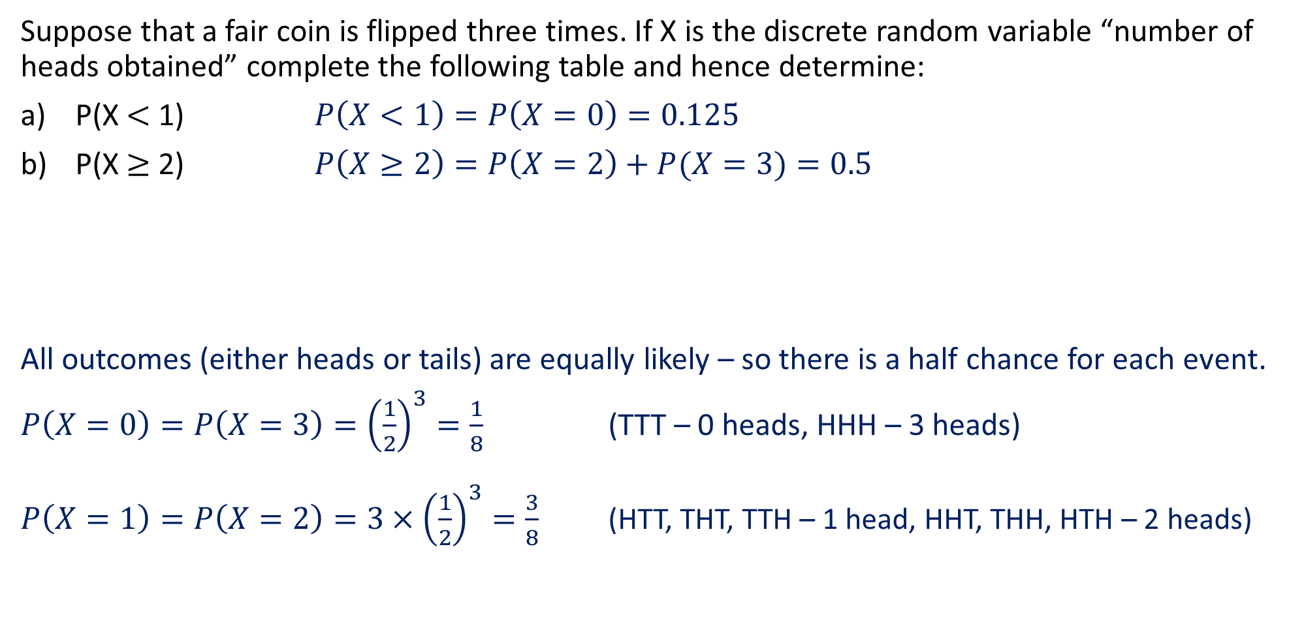
Guided Practice
Suppose that a fair coin is flipped three times. If X is the discrete random variable “number of heads obtained” complete the following table and hence determine:
P(X $<$ 1) $P\left(X<1\right)=P\left(X=0\right)=0.125$
P(X $≥$ 2) $P\left(X≥2\right)=P\left(X=2\right)+P(X=3)=0.5$
All outcomes (either heads or tails) are equally likely – so there is a half chance for each event.
$P\left(X=0\right)=P\left(X=3\right)={\left(\frac{1}{2}\right)}^{3}=\frac{1}{8}$ (TTT – 0 heads, HHH – 3 heads)
$P\left(X=1\right)=P\left(X=2\right)={3×\left(\frac{1}{2}\right)}^{3}=\frac{3}{8}$ (HTT, THT, TTH – 1 head, HHT, THH, HTH – 2 heads)
X | 0 | 1 | 2 | 3
P(X = x)
0.125
0.375
0.375
0.125

Slide 4

Key Features and Terminology
X | 0 | 1 | 2 | 3
P(X = x)
0.125
0.375
0.375
0.125
The table above is called the probability distribution of the random variable X.
One of the key features of a PDF is that the sum of its probabilities must equal to 1.
The probability distribution table could be converted into a cumulative probability table. The table below shows this, and is called the cumulative distribution of the random variable X.
Notice that we are summing the probabilities from the PDF as we progress through each value in the CDF, such that the total sum at the end should be 1.
X | 0 | 1 | 2 | 3
P(X ≤ x)
0.125
0.5
0.875
1

Slide 5
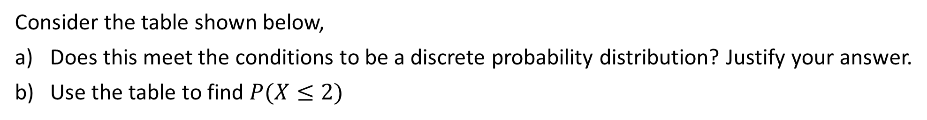
Guided Practice
Consider the table shown below,
Does this meet the conditions to be a discrete probability distribution? Justify your answer.
Use the table to find $P(X≤2)$
X | 0 | 1 | 2 | 3
P(X = x) | 0.2 | 0.3 | 0.1 | 0.4
a) Yes, each P(x) is between 0 and 1 and the sum of probabilities add up to 1
b) $P\left(X≤2\right)=P\left(0\right)+P\left(1\right)+P\left(2\right)=0.2+0.3+0.1=0.6$

Slide 6



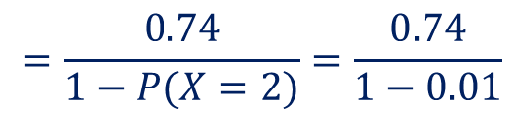



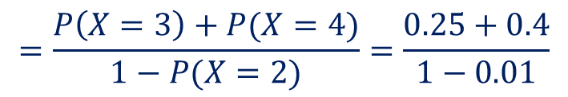
Guided Practice
The random variable X represents the number of chocolate chips in a certain brand of biscuits and is known to have the following probability distribution.
Determine
$P(X≥4)$
$P(X≥4|X>2)$
$P(X<5|X>2)$
X | 2 | 3 | 4 | 5 | 6 | 7
P(X = x) | 0.01 | 0.25 | 0.4 | 0.3 | 0.02 | 0.02
a) $P\left(X≥4\right)=P\left(X=4\right)+P\left(X=5\right)+P\left(X=6\right)+P\left(X=7\right)$
$$=0.4+0.3+0.02+0.02=0.74$$
b) $P\left(X≥4|X>2\right)=\frac{P\left(X≥4\right)}{P\left(X>2\right)}$
$$=\frac{0.74}{1−P(X=2)}=\frac{0.74}{1−0.01}$$
$$=\frac{74}{99}$$
c) $P\left(x<5|X>2\right)=\frac{P(2<X<5)}{P\left(X>2\right)}$
$$=\frac{P\left(X=3\right)+P(X=4)}{1−P(X=2)}=\frac{0.25+0.4}{1−0.01}$$
$$=\frac{65}{99}$$

Slide 7
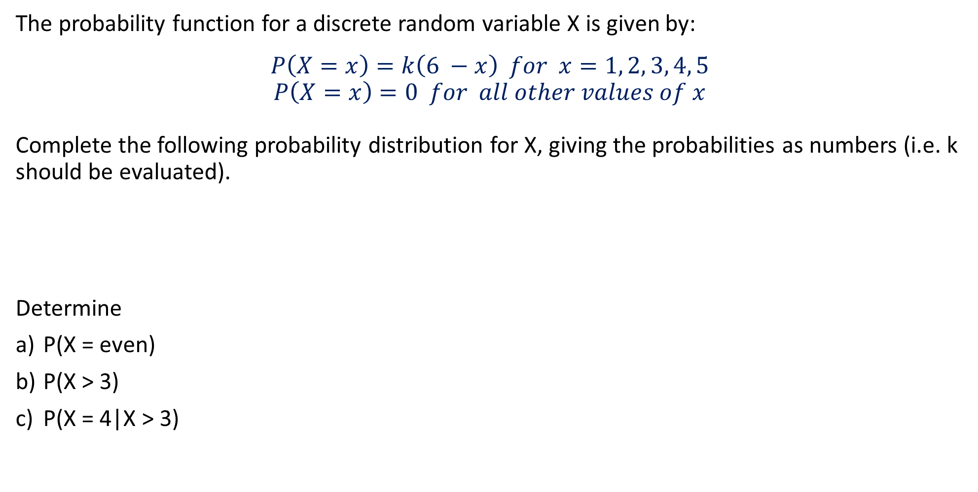
Guided Practice
The probability function for a discrete random variable X is given by:
$$P\left(X=x\right)=k\left(6 −x\right) for x=1, 2, 3, 4, 5$$
$$P\left(X=x\right)=0 for all other values of x$$
Complete the following probability distribution for X, giving the probabilities as numbers (i.e. k should be evaluated).
Determine
P(X = even)
P(X > 3)
P(X = 4|X > 3)
X | 1 | 2 | 3 | 4 | 5
P(X = x)

Slide 8
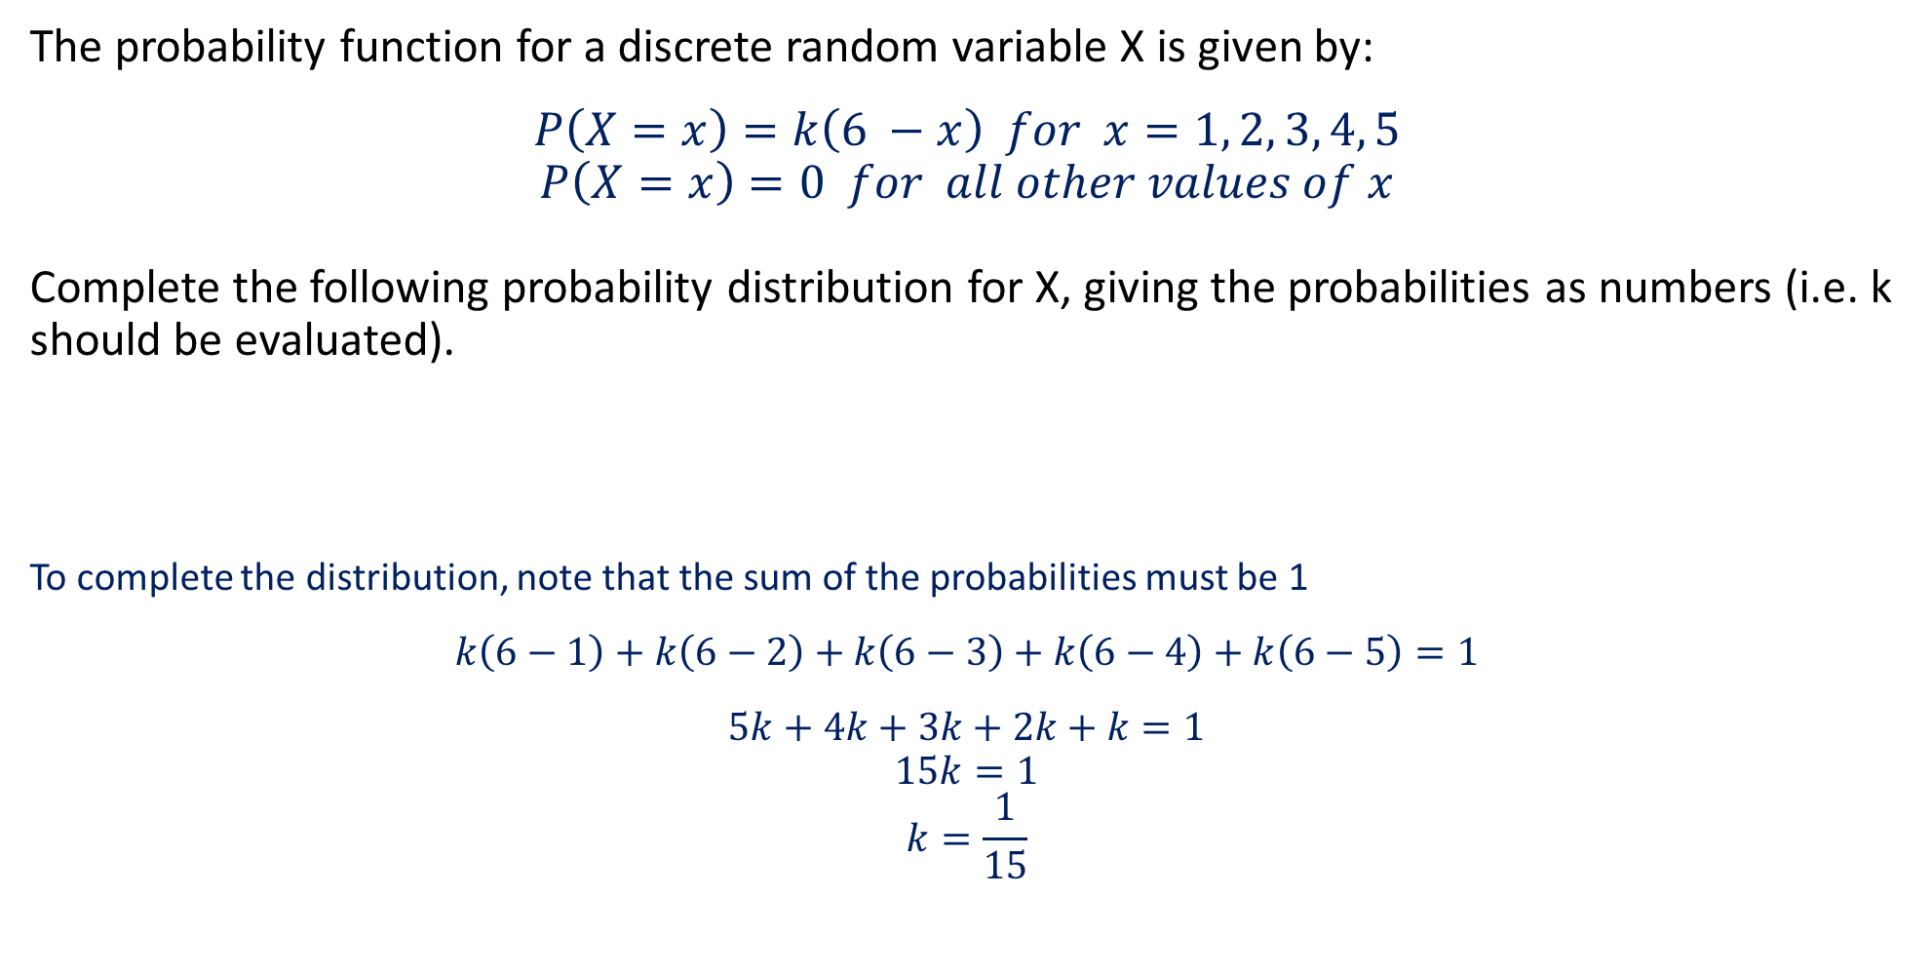
Guided Practice
The probability function for a discrete random variable X is given by:
$$P\left(X=x\right)=k\left(6 −x\right) for x=1, 2, 3, 4, 5$$
$$P\left(X=x\right)=0 for all other values of x$$
Complete the following probability distribution for X, giving the probabilities as numbers (i.e. k should be evaluated).
To complete the distribution, note that the sum of the probabilities must be 1
$$k\left(6−1\right)+k\left(6−2\right)+k\left(6−3\right)+k\left(6−4\right)+k\left(6−5\right)=1$$
$$5k+4k+3k+2k+k=1$$
$$15k=1$$
$$k=\frac{1}{15}$$
X | 1 | 2 | 3 | 4 | 5
P(X = x)
1/3
4/15
1/5
2/15
1/15

Slide 9
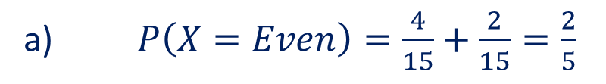

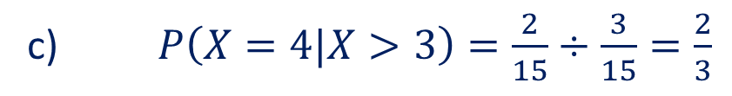
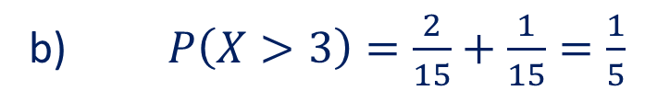
Guided Practice
The probability function for a discrete random variable X is given by:
$$P\left(X=x\right)=k\left(6 −x\right) for x=1, 2, 3, 4, 5$$
$$P\left(X=x\right)=0 for all other values of x$$
Complete the following probability distribution for X, giving the probabilities as numbers (i.e. k should be evaluated).
Determine
P(X = Even)
P(X > 3)
P(X = 4|X > 3)
X | 1 | 2 | 3 | 4 | 5
P(X = x)
1/3
4/15
1/5
2/15
1/15
a) $P\left(X=Even\right)=\frac{4}{15}+\frac{2}{15}=\frac{2}{5}$
b) $P\left(X>3\right)=\frac{2}{15}+\frac{1}{15}=\frac{1}{5}$
c) $P\left(X=4|X>3\right)=\frac{2}{15}÷\frac{3}{15}=\frac{2}{3}$

Slide 10

Guided Practice
A spinner shows the numbers 1, 2, 3
For each spin of this spinner, the probability associated with each outcome, 1, 2, or 3, is as show in the table
Determine
The value of k
The Spinner is spun twice, Determine the probability of getting:
a 2 and then a 3
a 2 and a 3 in any order
The same number twice
A total of 3 when the 2 numbers obtained are added together
A 2 on the second spin given that the 2 spins give a total of 4
X | 1 | 2 | 3
P(X = x) | 0.5 | 0.3 | k
$$0.5+0.3+k=1⇒k=0.2$$

Slide 11

Guided Practice
A spinner shows the numbers 1, 2, 3
For each spin of this spinner, the probability associated with each outcome, 1, 2, or 3, is as show in the table
The Spinner is spun twice, Determine the probability of getting:
a 2 and then a 3
a 2 and a 3 in any order
The same number twice
A total of 3 when the 2 numbers obtained are added together
A 2 on the second spin given that the 2 spins give a total of 4
X | 1 | 2 | 3
P(X = x) | 0.5 | 0.3 | 0.2
$$P\left(2 then 3\right)=P\left(2\right)×P\left(3\right)=0.2×0.3=0.06$$
$$P\left(2 and 3 in any order\right)=P\left(2\right)×P\left(3\right)+P\left(3\right)×P\left(2\right)=2\left(0.06\right)=0.12$$
$$P\left(same number twice\right)=P\left(1\right)×P\left(1\right)+P\left(2\right)×P\left(2\right)+P\left(3\right)×P\left(3\right)=0.25+0.09+0.04=0.38$$

Slide 12

Guided Practice
A spinner shows the numbers 1, 2, 3
For each spin of this spinner, the probability associated with each outcome, 1, 2, or 3, is as show in the table
The Spinner is spun twice, Determine the probability of getting:
d) A total of 3 when the 2 numbers obtained are added together
e) A 2 on the second spin given that the 2 spins give a total of 4
X | 1 | 2 | 3
P(X = x) | 0.5 | 0.3 | 0.2
$$P\left(sum of 3\right)=P\left(1 then 2\right)+P(2 then 1)$$
$$=0.5×0.3+0.3×0.5=0.3$$
$$P\left(2 on second spin |sum of 4 \right)=\frac{P\left(2 then 2\right)}{P\left(sum of 4\right)}$$
$$=\frac{0.3×0.3}{\left(0.3×0.3\right)+2(0.2×0.5)}=\frac{9}{29}$$

Slide 13
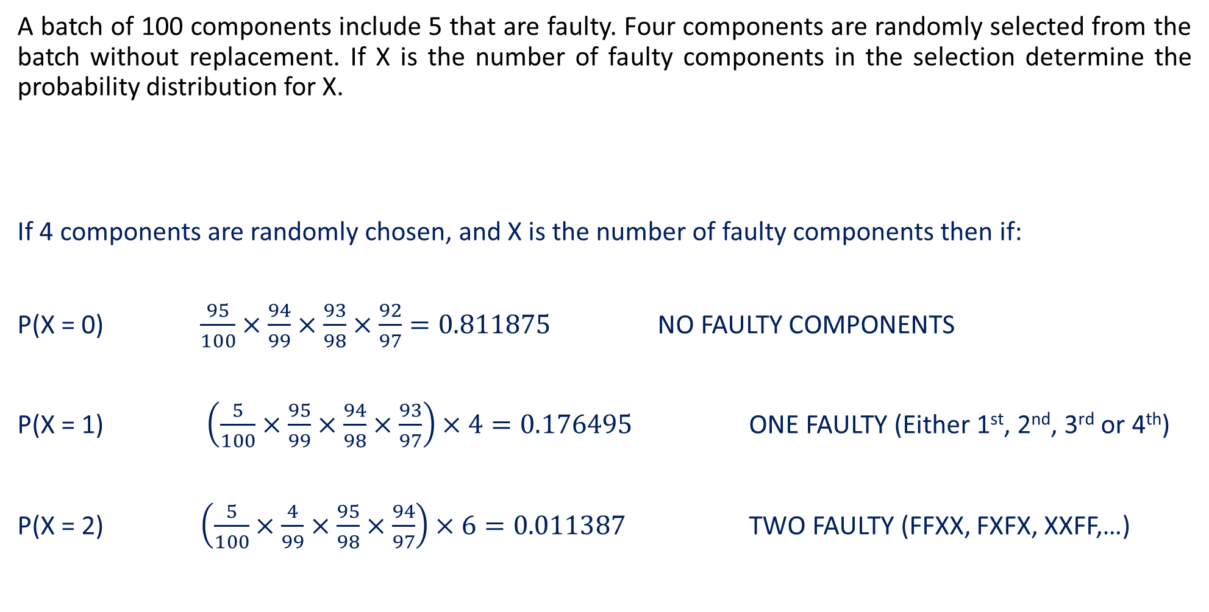
Guided Practice
A batch of 100 components include 5 that are faulty. Four components are randomly selected from the batch without replacement. If X is the number of faulty components in the selection determine the probability distribution for X.
If 4 components are randomly chosen, and X is the number of faulty components then if:
P(X = 0) $\frac{95}{100}×\frac{94}{99}×\frac{93}{98}×\frac{92}{97}=0.811875$ NO FAULTY COMPONENTS
P(X = 1) $\left(\frac{5}{100}×\frac{95}{99}×\frac{94}{98}×\frac{93}{97}\right)×4=0.176495$ ONE FAULTY (Either 1st, 2nd, 3rd or 4th)
P(X = 2) $\left(\frac{5}{100}×\frac{4}{99}×\frac{95}{98}×\frac{94}{97}\right)×6=0.011387$ TWO FAULTY (FFXX, FXFX, XXFF,…)
X | 0 | 1 | 2 | 3 | 4
P(X = x)
0.811875
0.176495
0.011387
0.000242
0.000001

Slide 14
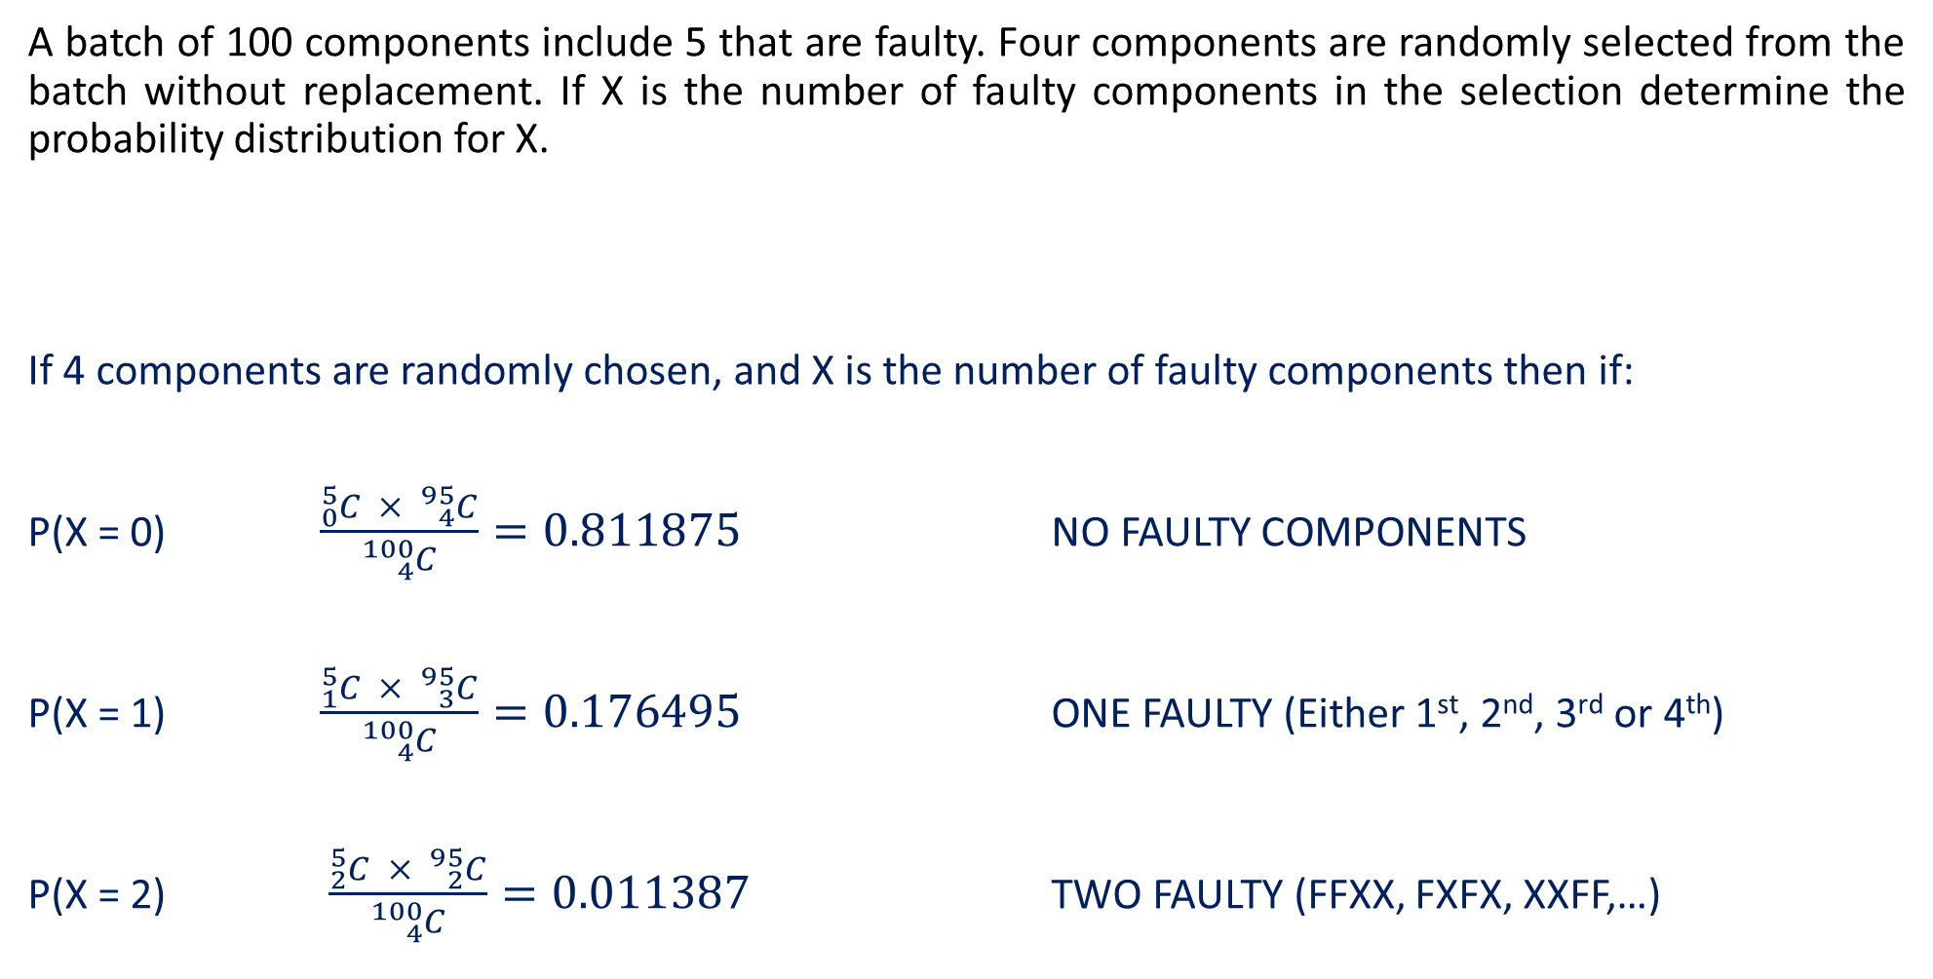
Guided Practice (Alternative)
A batch of 100 components include 5 that are faulty. Four components are randomly selected from the batch without replacement. If X is the number of faulty components in the selection determine the probability distribution for X.
If 4 components are randomly chosen, and X is the number of faulty components then if:
P(X = 0) $\frac{{}_{0}^{5}C × {}_{4}^{95}C}{{}_{4}^{100}C}=0.811875$ NO FAULTY COMPONENTS
P(X = 1) $\frac{{}_{1}^{5}C × {}_{3}^{95}C}{{}_{4}^{100}C}=0.176495$ ONE FAULTY (Either 1st, 2nd, 3rd or 4th)
P(X = 2) $\frac{{}_{2}^{5}C × {}_{2}^{95}C}{{}_{4}^{100}C}=0.011387$ TWO FAULTY (FFXX, FXFX, XXFF,…)
X | 0 | 1 | 2 | 3 | 4
P(X = x)
0.811875
0.176495
0.011387
0.000242
0.000001

Slide 15
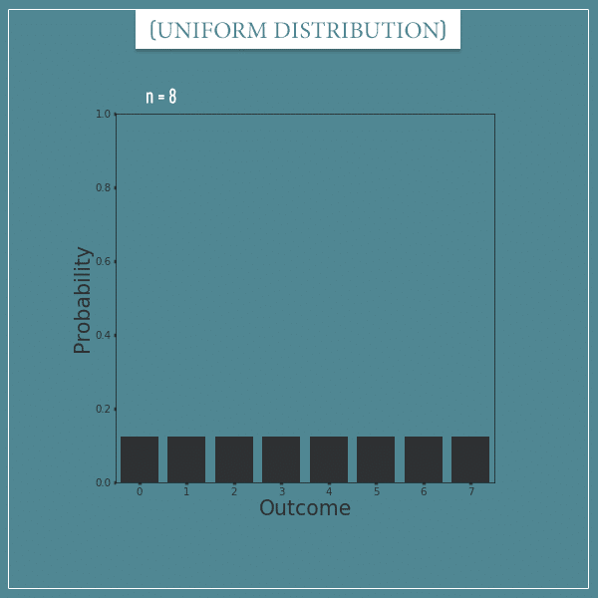
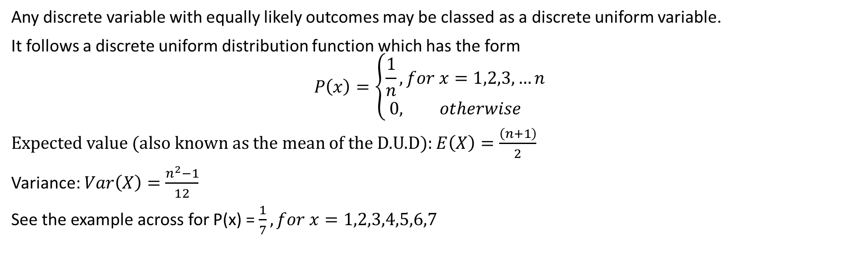
Discrete Uniform Distribution
Any discrete variable with equally likely outcomes may be classed as a discrete uniform variable.
It follows a discrete uniform distribution function which has the form
$$P\left(x\right)=\left\{\begin{aligned}\frac{1}{n}, for x=1,2,3,…n \\ 0, otherwise \end{aligned}\right.$$
Expected value (also known as the mean of the D.U.D): $E\left(X\right)=\frac{\left(n+1\right)}{2}$
Variance: $Var\left(X\right)=\frac{n^{2}−1}{12}$
See the example across for P(x) = $\frac{1}{7}, for x=1,2,3,4,5,6,7$

Slide 16
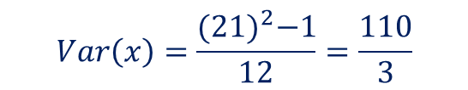


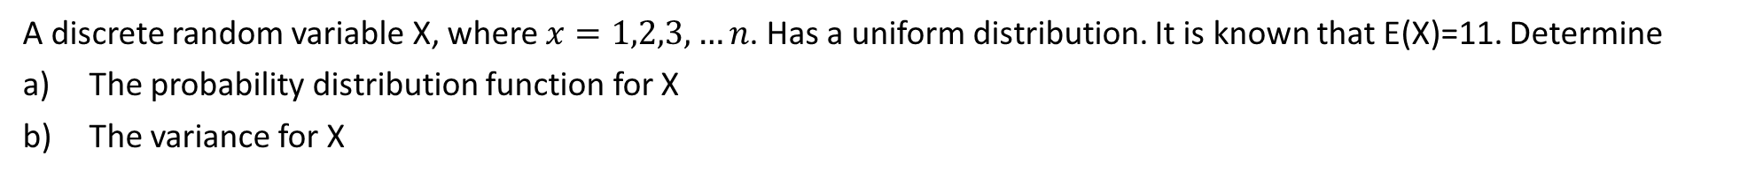
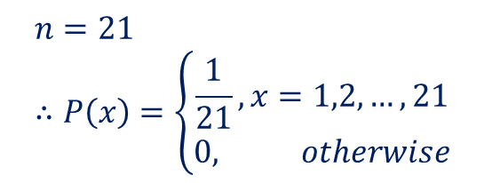


Guided Practice
A discrete random variable X, where $x=1,2,3,…n$. Has a uniform distribution. It is known that E(X)=11. Determine
The probability distribution function for X
The variance for X
$$E\left(X\right)=\frac{n+1}{2}$$
$$11=\frac{n+1}{2}$$
$$22=n+1$$
$$n=21 \\ ∴P\left(x\right)=\left\{\begin{aligned}\frac{1}{21}, x=1,2,…, 21 \\ 0, otherwise\end{aligned}\right.$$
$$Var\left(x\right)=\frac{n^{2}−1}{12}$$
$$Var\left(x\right)=\frac{{(21)}^{2}−1}{12}=\frac{110}{3}$$

Slide 17
Independent Practice
Complete Cambridge Ex 8C

